Slide 1



Process Synchronization
Ms.swati Mali
Ms. Nirmala Shinde

Slide 2


Process Synchronization
Processes can execute concurrently but May be interrupted at any time, partially completing execution
Concurrent access to shared data may result in data inconsistency
Maintaining data consistency requires mechanisms to ensure the orderly execution of cooperating processes

Slide 3
Producer Consumer Problem Revisited
Modifying the Bounded Buffer Approach for Producer and Consumer Problem.
Having a counter that keeps track of the number of full buffers.
incremented every time on addition of a new item to the buffer
decremented every time on removal of one item from the buffer.

Slide 4
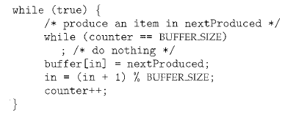
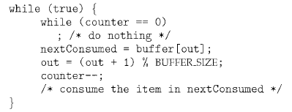
Producer Consumer Problem
The code for the producer-consumer process can be modified as follows:

Slide 5
Issue?
" counter++" may be implemented in machine language as –
register1 = counter
register1 = register1 + 1
counter= register1
register1 is one of the local CPU registers.
"counter--" is implemented as follows:
register2 = counter
register2 = register2 ~ 1
counter= register2
register2 is one of the local CPU registers.

Slide 6

Producer Consumer Problem Revisited
What if counter and registers are not protected against data inconsistency?

Slide 7
Producer Consumer Problem Revisited
If the order of the statements at T4 and T5 is reversed, we would arrive at the incorrect state
Result=> "counter == 6“, incorrect state
we allowed both processes to manipulate the variable counter concurrently. – Race Condition

Slide 8
The Critical Section Problem

Slide 9
The Critical Section Problem
Consider a system consisting of n processes {Po, P1 , ... , Pn-1}.
Critical Section-
Each process has a segment of code, called a critical section in which the process may be
changing common variables,
updating a table,
writing a file, and so on.

Slide 10
The Critical Section Problem
When one process is executing in its critical section,
No other process is to be allowed to execute in its critical section.
Execution of Critical Sections by the processes is mutually exclusive
Critical-section problem is to design a protocol that the processes can use to cooperate.

Slide 11
The Critical Section Problem
Entry section
Each process must request permission to enter its critical section. The section of code implementing this request is the entry section.
Exit Section
The critical section may be followed by an exit section.
Remaining Section
The remaining code is the remaining section.

Slide 12
The Critical Section Problem
Solution must Satisfy three requirements-
Mutual Exclusion
Progress
Bounded Waiting

Slide 13
Reading Assignment; why bounded waiting?
Bounded Waiting: Guarantees fairness by limiting wait times.
Busy Waiting: Continuous polling, wastes CPU cycles.
Unbounded Waiting: No guarantees on wait time, leads to starvation.
Blocking (Sleep Waiting): Process sleeps until a condition is met, saves CPU cycles.
Starvation: Indefinite waiting due to unfair resource allocation.
Priority Inversion: High-priority process waits on a lower-priority process.
Conditional Waiting: Waits for a condition to become true.
Voluntary Waiting: A process yields control voluntarily.
Preemptive Waiting: Process is forcibly removed from the CPU.

Slide 14
The Critical Section Problem
Mutual Exclusion: If Process P_{i} is executing in its critical section, then no other processes can be executing in their critical sections
Progress :
Only those processes interested in entering CS , should compete to enter CS.
Bounded Waiting :
After a max bound/time limit , the process definitely will get a chance to enter CS

Slide 15
Reading slides: Critical-Section Handling in OS
Why would anyone favour a preemptive kernel over a non-preemptive one?
A preemptive kernel
is more suitable for real-time programming, as it will allow a real-time process to preempt a process currently running in the kernel.
may be more responsive, since there is less risk that a kernel-mode process will run for an arbitrarily long period before relinquishing the processor to waiting processes.

Slide 16
Solutions to Mutual exclusion problems
Software support
Hardware support
Support from Programming languages
Support from OS

Slide 17
solution mechanisms to achieve concurrency
Software approach:
Here no hardware, OS, or programming language level supported is assumed.
Burdens programmers to write the programs (which when executed becomes processes) to achieve concurrency themselves.
Dekker’s or Peterson’s algorithms are known for the software approach solutions to mutual exclusion.
Hardware approach :
Use of special hardware instructions and control over the hardware such as disabling the interrupts.
Support from operating systems and programming languages:
Here, the operating system offers support to some signals
the programmers can be provided with language constructs or library with which they can easily write the code for the process synchronize with each other.

Slide 18
Requirements for mutual exclusion
Mutual exclusion must be enforced: Only one process at a time is allowed into its critical section
A process that halts in its noncritical section must do so without interfering with other processes.
The solution must ensure that there is no deadlock or starvation.
When no process is in a critical section, any process that requests entry to its critical section must be permitted to enter without delay.
No assumptions are made about relative process speeds or number of processors.
A process remains inside its critical section for a finite time only
Mutual exclusion techniques can be used to resolve conflicts, such as competition for resources, and to synchronize processes so that they can cooperate

Slide 19
Illustration of Mutual Exclusion
/* PROCESS 1 */ void P1 { while (true) { /* preceding code /; EnterCriticalSection (Ra); /* Execute Critical Section */; ExitCriticalSection (Ra); /* remaining code */; } } | /* PROCESS 2 */ void P2 { while (true) { /* preceding code */; EnterCriticalSection (Ra); /* Execute Critical Section */; ExitCriticalSection (Ra); /* remaining code */; } } | … | /* PROCESS n */ void Pn { while (true) { /* preceding code */; EnterCriticalSection (Ra); /* Execute Critical Section */; ExitCriticalSection (Ra); /* remaining code */; } }

Slide 20
Software support

Slide 21
Reading Assignment
Attempt One |  | Attempt Two
/* Process 0*/ . . . while(turn!=0) /* do nothing */; /*critical section*/; turn =1; . . | /* Process 1*/ . . . while(turn!=1) /* do nothing */; /*critical section*/; turn =0; . . | /* Process 0*/ . . . while(flag[1]) /* do nothing */; flag[0]=true; /*critical section*/; flag[0]=false; . . | /* Process 1*/ . . . while(flag[0]) /* do nothing */; flag[1]=true; /*critical section*/; flag[1]=false; . .
First Attempt: Succeeds in enforcing mutual exclusion Uses variable to control which thread can execute Constantly tests whether critical section is available Busy waiting Wastes significant processor time Problem known as strict alternation synchronization Each thread can execute only in strict alternation |  | Second Attempt: Removes strict alternation synchronization Violates mutual exclusion Thread could be preempted while updating flag variable Not an appropriate solution

Slide 22
Reading Assignment
Attempt Three |  | Attempt Four
/* Process 0*/ . . . flag[0]=true; while(flag[1]) /* do nothing */; /*critical section*/; flag[0]=false; ; . . | /* Process 1*/ . . . flag[1]=true; while(flag[0]) /* do nothing */; /*critical section*/; flag[1]=false; ; . . | /* Process 0*/ . . . flag[0]=true; while(flag[1]) { flag[0]=false; /*delay*/ flag[0]=true; } /*critical section*/; flag[0]=false; . . | /* Process 1*/ . . . flag[1]=true; while(flag[0]) { flag[1]=false; /*delay*/ flag[1]=true; } /*critical section*/; flag[1]=false; . .
Third Attempt: Set critical section flag before entering critical section test Once again guarantees mutual exclusion Introduces possibility of deadlock Both threads could set flag simultaneously Neither would ever be able to break out of loop Not a solution to the mutual exclusion |  | Fourth Attempt: Sets flag to false for small periods of time to yield control Solves previous problems, introduces indefinite postponement Both threads could set flags to same values at same time Would require both threads to execute in tandem (unlikely but possible) Unacceptable in mission- or business-critical systems

Slide 23
Correct solutions: Dekker’s solution
boolean flag [2]; int turn; | void main() { flag[0]=flag[1]=false; turn=1; parbegin(P0,P1); }
void P0() { while (true) { flag[0]=true; while (flag[1]) if (turn==1) { flag[0]=false; while (turn==1) /* Do Nothing*/ flag[0]=true; } /*Critical Section */ turn=1; flag[0]=false; /*Remainder Code*/ } } | void P1() { while (true) { flag[1]=true; while (flag[0]) if (turn==0) { flag[1]=false; while (turn==0) /* Do Nothing*/ flag[1]=true; } /*Critical Section */ turn=0; flag[1]=false; /*Remainder Code*/ } }
The characteristics:
Proper solution
Guarantees mutual exclusion
Avoids previous problems of deadlock, indefinite postponement
Uses notion of favored threads to determine entry into critical sections
Resolves conflict over which thread should execute first
Each thread temporarily unsets critical section request flag
Favored status alternates between threads
wasn’t accepted as a solution to mutual exclusion as it could support only two processes and in the real scenario system has many processes to handle.

Slide 24
Correct solutions: Peterson’s solution
void Pi() { While (true) { flag[i] := true; turn := j; while (flag[ j] and turn = j ) /*Do Nothing*/ ; /*Critical Section */ flag[i] := false; /*Remainder Section*/ } } | boolean flag[n]; Int turn; void main() { flag[i] := false; flag[ j] := false; parbegin(Pi,Pj,….Pn); }
The characteristics:
Proper solution
Guarantees mutual exclusion
Avoids problems of deadlock, indefinite postponement
Uses notion of favored threads to determine entry into critical sections
Resolves conflict over which thread should execute first
Each thread temporarily unsets critical section request flag
Favored status alternates between threads
Can be applied to any number of processes

Slide 25
Expected outcome of reading assignment: Detect Livelock Detect Deadlock Detect bounded waiting Detect Progress

Slide 26
Livelock situation while inserting a node in BST
Process P1:
while True:
Lock tree for insertion
if P2 is waiting to insert a node: Release tree lock
Wait for P2 to finish its operation
else:
Insert node A
Release tree lock
break
# Exit loop when insertion is successful
Process P2:
while True:
Lock tree for insertion
if P1 is waiting to insert a node:
Release tree lock
Wait for P1 to finish its operation
else:
Insert node B
Release tree lock
break
# Exit loop when insertion is successful

Slide 27
Deadlock situation
Process P1:
Lock R1
Wait(100 ms) # some work with R1
Lock R2 # Trying to lock R2
(but P2 may have already locked R2)
// Critical section using R1 and R2
Unlock R2
Unlock R1
Process P2:
Lock R2
Wait(100 ms) # some work with R2
Lock R1 # Trying to lock R1
(but P1 may have already locked R1)
// Critical section using R2 and R1
Unlock R1
Unlock R2

Slide 28
Busywait situation while inserting a node in BST
Shared Variable:
is_inserting = False // Flag to indicate if insertion is in progress
Algorithm InsertNode(root, key):
while is_inserting == True: // Busy waiting loop
// Do nothing, just wait until is_inserting becomes False
continue
// Set is_inserting to True to indicate this process is inserting
is_inserting = True
if root is NULL:
root = CreateNewNode(key)
else if key < root.value:
root.left = InsertNode(root.left, key)
else if key > root.value:
root.right = InsertNode(root.right, key)
// Insertion is done, set is_inserting to False
is_inserting = False
return root

Slide 29
Hardware Synchronization

Slide 30
Hardware approaches to enforce mutual exclusion
Disabling interrupt and
Use of special instructions.

Slide 31
Disabling interrupt
In a uniprocessor system, concurrent processes are not overlapped but they can only be interleaved.
Furthermore, a process executes until it calls an OS service or until it is interrupted.
Thus, it is sufficient to prevent a process from being interrupted to guarantee mutual exclusion, This capability can be provided in the form of primitives defined by the OS kernel for disabling and enabling interrupts.

Slide 32
Disabling interrupt
The pseudo code:
while (true) {
/* disable interrupts */;
/* critical section */;
/* enable interrupts */;
/* remainder */;
}

Slide 33
Analysis: Disabling interrupt
As the processes are not interrupted, the mutual exclusion is guaranteed.
seems simple, the price paid for the same is very high.
As the processor is not allowed to interleave the processes, the efficiency and overall system performance degrades significantly.
Also, this particular solution will not work with multiprocessor architecture.
When the computer includes more than one processor, it is possible (and typical) for more than one process to be executing at a time. In this case, disabled interrupts do not guarantee mutual exclusion.

Slide 34
Special Machine Instructions:
In a multiprocessor systems, several processors share main memory.
Moreover, the interrupt disabling cannot help the mutual exclusion.
Special Atomic Hardware Instructions-
Atomic = Non-Interruptible
So to give mutually exclusive access to any memory location the processor designers have proposed several machine instructions that carry out some actions atomically, with one instruction fetch cycle.
Examples: compare&Swap, test&set, Exchange, etc

Slide 35
Special Machine Instructions: Compare & Swap
Compare & Swap Instruction
int compare_and_swap (int *word, int testvalue, int newvalue)
{
int oldvalue;
oldvalue = *word;
if (oldvalue == testvalue) *word = newvalue;
return oldvalue;
}

Slide 36
test_and_set Instruction
Definition:
boolean test_and_set (boolean *target)
{
boolean rv = *target;
*target = TRUE;
return rv:
}
Executed atomically
If 2 test and set instructions are executed simultaneously , they will be executed sequentially in some arbitary order.
Returns the original value of passed parameter i.e False
Set the new value of passed parameter to “TRUE”.

Slide 37
test_and_set Instruction
Definition:
boolean test_and_set (boolean *target)
{
boolean rv = *target;
*target = TRUE;
return rv:
}
Executed atomically
If 2 test and set instructions are executed simultaneously , they will be executed sequentially in some arbitary order.
Returns the original value of passed parameter i.e False
Set the new value of passed parameter to “TRUE”.

Slide 38
Mutual-exclusion implementation with TestAndSet ()
P0
do{ while(TestAndSet(&lock)); critical section lock=FALSE; remainder section }while(1);
P0 tries to enter CS
T&S returns False and set lock=True
While(False);
P0 comes out of while
Enter CS
Now P1 tries to enter CS
P0 is still inside CS and lock=true
Test&Set Returns the original value of passed parameter i.e. True
While(True);
Goes in Infinte Loop/Do Nothing
so P1 cannot enter CS

Slide 39
Mutual-exclusion implementation with TestAndSet ()
After completing CS
P0 makes lock=false
Exits CS
Enters RS
Now P1 can enter CS as lock is false now
Comes out of while loop
Executes CS
P0
do{ while(TestAndSet(&lock)); critical section lock=FALSE; remainder section }while(1);

Slide 40
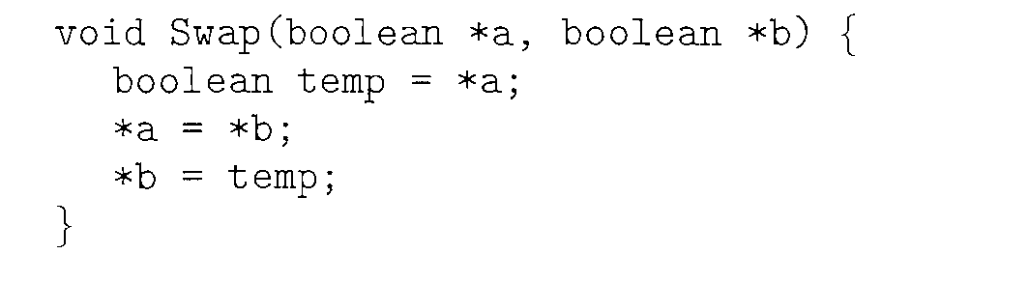
swap Instruction
Definition:
Swaps the contents of 2 memory word
Executed atomically=Non-interruptable

Slide 41
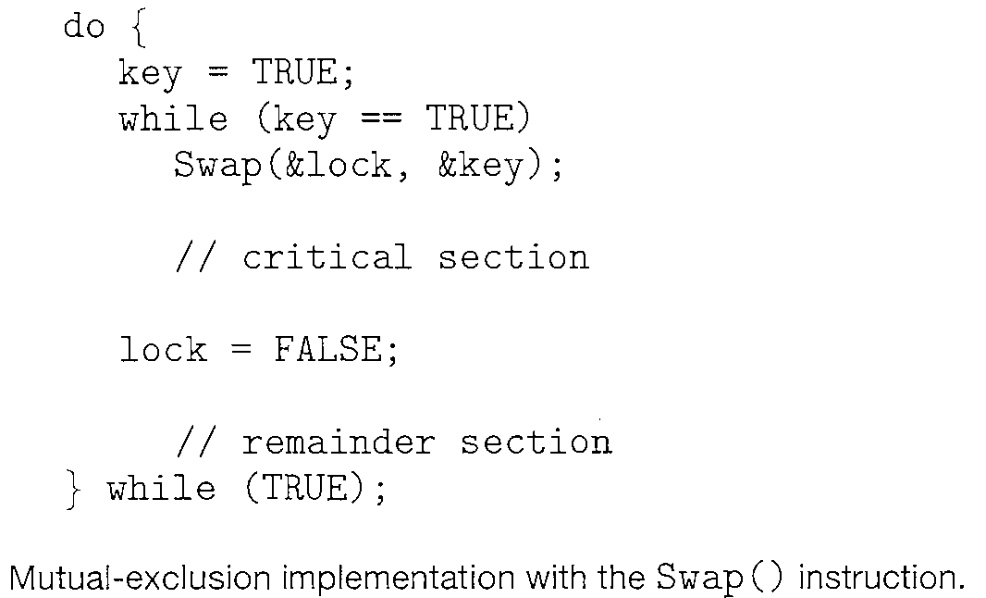
Mutual-exclusion implementation with swap ()
Solution:
Key=Local Variable=Each process has its own Key
Lock=Global Variable=Common for all Processes
Both Initialized to False

Slide 42
Mutual-exclusion implementation with swap ()
Initilally (L,K)=(F,F)
P0 makes key=true so
(L,K)=(F,T)
While key is true
Swap values of Key and Lock so
(L,K)=(T,F)
Key becomes false, exits while loop
Enters CS
Now P1 tries to enter CS
P1’s own key is False Initially
Global Lock is True as P0 is in CS
Key=true so
(L,K)=(T,T)
After Swapping also,
Key will always be True, So trapped in while loop
P1 will not be able to enter CS
Solution:

Slide 43
Mutual-exclusion implementation with swap ()
P0
Now, Lock=False and P0 exits CS
P0 enters RS
Now P1 tries to enter CS
So Pair (L,K)=(F,T)
The value will be swapped
Key will become False
Pair(L,K)=(T,F)
Control comes out of while
Enters CS
Solution:

Slide 44
Reading Assignment: Hardware Synchronization
Test Memory word and Set value-Test and Set()
Swap contents of two memory words-Swap()
These algorithms do not satisfy the bounded waiting requirement

Slide 45
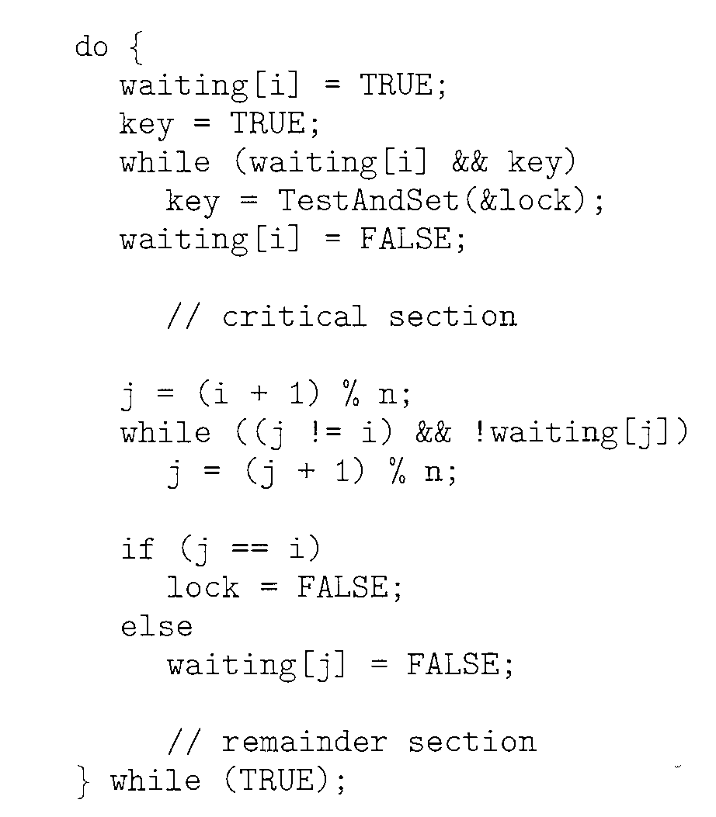
Reading Assignment: Bounded Waiting implementation with test and set ()
Solution:
Entry Code
Exit Code

Slide 46
Reading Assignment: Bounded Waiting implementation with test and set ()
Solution: Satisfies all 3 critical section requirements
Shared Data strcutures/Global variables
boolean waiting[n];
boolean lock;
Both initialized to false

Slide 47
Reading Assignment: Bounded Waiting implementation with test and set ()
Lock is initialized to False
Pi can enter its critical section only if either waiting[i]==false or key==false
The value of Key can become false only if Test&Set() is executed
The 1st process to execute the Test&Set() will set key==false and lock to True
waiting[i] of Pi=False
All other processes must wait

Slide 48
Reading Assignment: Bounded Waiting implementation with test and set ()
Lock=false
For Pi , waiting and Key both are True
while Condtn=True
Inside While Loop,
Key=T&S(&Lock)
So Key=False(Returns Original Value of Lock=False)
Lock=True
exit form While loop as Key=false
Waiting of Pi finishes=false
Enters Critical Section
Now Pj tries to enter Critical Section
waiting and key Both are True,
Lock=True
while conditn=True
Inside While Loop
Key=T&S(&Lock)
Key=True
Lock=True
Trapped in while loop

Slide 49
Reading Assignment: Bounded Waiting implementation with test and set ()
The hardware-based solutions to the CSP are complicated for application programmers to use.
Soln= Semaphore

Slide 50
Advantages of hardware approaches to enforce mutual exclusion.
The solution works with any number of processes on uniprocessor as well as multiprocessors architectures.
It is very simple and therefore easy to verify.
It can also support multiple critical sections; and each critical section can be defined by its own variable.

Slide 51
Disadvantages of hardware approaches to enforce mutual exclusion.
Busy waiting is employed.
Starvation is possible.
Deadlock is possible.
Consider the following scenario on a single-processor system.
Process P1 executes the special instruction (e.g., compare&swap, exchange) and enters its critical section.
P1 is then interrupted to give the processor to P2, which has higher priority.
If P2 now attempts to use the same resource as P1, it will be denied access because of the mutual exclusion mechanism.
Thus it will go into a busy waiting loop.
However, P1 will never be dispatched because it is of lower priority than another ready process, P2.
Because of the drawbacks of both the software and hardware solutions just outlined, we need to look for other mechanisms

Slide 52
Semaphores

Slide 53
Semaphore
Semaphore: Semaphore is an integer variable that can be initialized to some value.
The semaphore values are used for signaling the processes for communication.
The semaphores can be operated upon by three operations viz, initialize, increment and decrement.
All these operations are atomic
Depending on exact definition of semaphore, the decrement (wait) operation may block a process and the increment (signal) operation may unblock a process.
Semaphores are supported by operating system to achieve concurrency and synchronization.

Slide 54
Semaphores : Types of semaphore
Binary Semaphore:
Binary Semaphore is a semaphore that takes on only the values 0 and 1.
General or counting Semaphore:
Any Semaphore that is not restricted to have value only 0 and 1 and can have values >=2 are called general or counting semaphores.
In other words, the nonbinary semaphore is often referred to as either a counting semaphore or a general semaphore.
Strong Semaphore:
A semaphore whose definition includes FCFS policy when it is unblocked from the blocked queue, is called a Strong Semaphore.
Weak Semaphore:
A semaphore whose definition does not include any policy when it is unblocked from the blocked queue, is called a Weak Semaphore.

Slide 55
Mutex
Short for mutual exclusion object.
A mutex is a program object that allows multiple program threads to share the same resource, such as file access, but not simultaneously.
A mutex object only allows one thread into a controlled section, forcing other threads which attempt to gain access to that section to wait until the first thread has exited from that section.
When a program is started, a mutex is created with a unique name.
After this stage, any thread that needs the resource must lock the mutex from other threads while it is using the resource.
The mutex is set to unlock when the data is no longer needed or the routine is finished.

Slide 56
Mutex and Binary Semaphores
Mutex is a specialized form of binary semaphore designed specifically for mutual exclusion with the added restriction that only the thread that locks the mutex can unlock it.
Binary Semaphore is more general and can be used for signaling and synchronization, not necessarily tied to ownership of resources.

Slide 57
Mutex and Binary Semaphores
Aspect | Mutex | Binary Semaphore
Ownership | A mutex can only be released (unlocked) by the thread that acquired (locked) it. | A binary semaphore can be signaled (released) by any thread, even one that didn’t wait (acquire) it.
Use Case | Typically used for locking a resource or critical section, where ownership is important. | Typically used for signaling between processes or threads, not necessarily for resource locking.
Purpose | Specifically designed for mutual exclusion. | Designed for signaling (can be used for both synchronization and mutual exclusion).
Overhead | Generally has lower overhead since it's specifically designed for locking mechanisms. | Slightly higher overhead due to its more general-purpose use in synchronization.
Priority Inversion Handling | Mutexes often come with built-in mechanisms to prevent priority inversion (e.g., priority inheritance). | Binary semaphores do not typically have built-in mechanisms to handle priority inversion.
Typical API | lock() and unlock(). | wait() (or P()) and signal() (or V()).

Slide 58
semaphore primitives
Semaphore is an integer variable that can be initialized to some value.
The semaphore values are used for signaling the processes for communication.
They can be operated upon by three operations viz,
initialize,
increment and
decrement.
All these operations are atomic in nature.
Depending on exact definition of semaphore, the decrement (wait) operation may block a process and the increment (signal) operation may unblock a process.

Slide 59
Definition of Semaphore Primitives
struct semaphore {
int count;
queueType queue;
};
void semWait(semaphore s)
{
s.count--;
if (s.count < 0) {
/* place this process in s.queue */;
/* block this process */;
}
}
void semSignal(semaphore s)
{
s.count++;
if (s.count <= 0) {
/* remove a process P from s.queue */;
/* place process P on ready list */;
}
}

Slide 60
/* program mutualexclusion */
const int n = /* number of processes */;
semaphore s = 1;
void P(int i)
{
while (true) {
semWait(s);
/* critical section */;
semSignal(s);
/* remainder */;
}
}
void main()
{
parbegin (P(1), P(2), . . ., P(n));
}

Slide 61
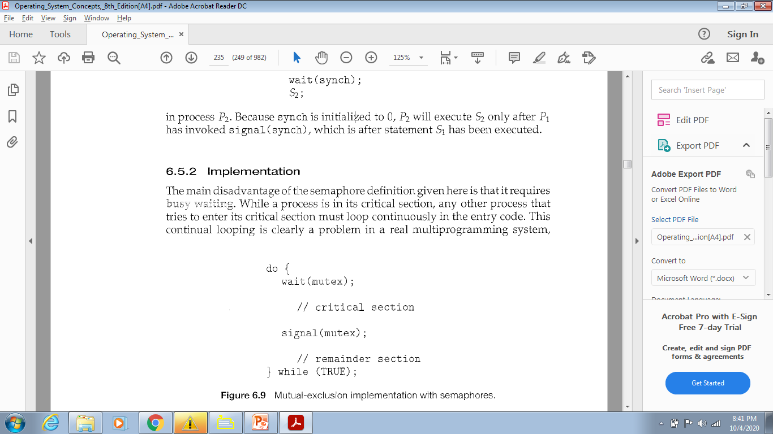
Binary Semaphore
Mutual Exclusion using Binary Semaphore
Used to deal with the critical-section problem for multiple processes.
Processes share a semaphore, mutex, initialized to 1.
wait(S) {
while S <= 0
; II no-op
s--;
}

Slide 62
Mutual Exclusion using Binary Semaphore
Process P0 tries to enter the CS
P0
while(mutex<=0);
mutex=1 so Condition is False
Comes out of while loop
mutex - -
so mutex=0
Now P1 tries to enter CS
while(mutex<=0);
condition is True , so P1 gets trapped in a Do Nothing Loop
P1 cannot enter CS ============>ME preserved
wait(S) {
while S <= 0
; II no-op
s--;
}

Slide 63
Semaphore
We can also use semaphores to solve various synchronization problems.
Consider two concurrently running processes:
P1 with a statement S1
P2 with a statement S2 .
Suppose we require that S2 be executed only after S1 has completed.

Slide 64
Semaphore
Let P1 and P2 share a common semaphore synch, initialized to 0
Statements inserted in P1
S1;
signal(synch) ;
Statements inserted in P2
wait(synch);
S2;
Because synch is initialized to 0,
P2 will execute S2 only after P1 has invoked signal (synch), which is after statement S1 has been executed.
Else P2 will caught in infinte loop inside wait() fn
wait(S) {
while S <= 0
; II no-op
s--;
}

Slide 65

ISRO | ISRO CS 2017 – May | Question 78
At particular time, the value of a counting semaphore is 10, it will become 7 after: (a) 3 V operations (b) 3 P operations (c) 5 V operations and 2 P operations (d) 2 V operations and 5 P operations
Which of the following option is correct? (A) Only (b) (B) Only(d) (C) Both (b) and (d) (D) None of these
wait () operation = originally termed P
from the Dutch proberen,
Meaning "to test“ or “to attempt”
signal() operation = originally called V
from verhogen,
Meaning "to increment

Slide 66
ISRO | ISRO CS 2017 – May | Question 78
At particular time, the value of a counting semaphore is 10, it will become 7 after: (a) 3 V operations (b) 3 P operations (c) 5 V operations and 2 P operations (d) 2 V operations and 5 P operations Which of the following option is correct? (A) Only (b) (B) Only(d) (C) Both (b) and (d) (D) None of these Answer: (C) Explanation: P: Wait operation decrements the value of the counting semaphore by 1. V: Signal operation increments the value of counting semaphore by 1. Current value of the counting semaphore = 10 a) after 3 P operations, value of semaphore = 10-3 = 7 d) after 2 v operations, and 5 operations value of semaphore = 10 + 2 – 5 = 7 Hence option (C) is correct.

Slide 67
UGC-NET | UGC NET CS 2018 July – II | Question 51
At a particular time of computation, the value of a counting semaphore is 10. Then 12 P operations and “x” V operations were performed on this semaphore. If the final value of semaphore is 7, x will be: (A) 8 (B) 9 (C) 10 (D) 11 Answer: (B) Explanation: Intially the value of a counting semaphore is 10 Now 12 P operation are performed. Now counting semaphore value = -2 “x” V operations were performed on this semaphore and final value of counting semaphore = 7 i.e x + (-2) = 7 x = 9. So, option (C) is correct.

Slide 68
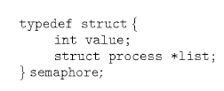
Semaphore Definition
With each semaphore there is an associated waiting queue
Each entry in a waiting queue has two data items:
value (of type integer)
pointer to next record in the list

Slide 69
Semaphore Definition
Wait()
When a process must wait on a semaphore, it is added to the list of processes.
Signal()
A signal() operation removes one process from the list of waiting processes and awakens that process

Slide 70
Implementation with no busy waiting
We modify the definition of the wait() and signal() semaphore operations.
When a process executes the wait () operation and finds that the semaphore value is not positive, it must wait.
Rather than busy waiting, the process can block itself.

Slide 71
Implementation with no busy waiting
Two operations:
block
wakeup

Slide 72
Implementation with no busy waiting
Two operations:
block –
The block() operation suspends the process that invokes it.
place the process invoking the operation on the waiting queue associated with the semaphore
The state of the process is switched to the waiting state.
Control transferred to the CPU scheduler, which selects another process to execute.

Slide 73
Implementation with no busy waiting
wakeup –
A process that is blocked, waiting on a semaphore S, should be restarted
when some other process executes a signal() operation.
The process is restarted by a wakeup () operation

Slide 74
Implementation with no busy waiting
wakeup –
The wakeup(P) operation resumes the execution of a blocked process P.
Remove one of processes in the waiting queue and place it in the ready queue
Changes the process state from waiting to ready
These two operations are provided by the operating system as basic system calls.

Slide 75
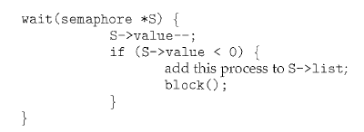
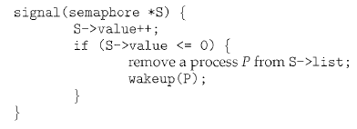
Implementation with no busy waiting

Slide 76
Implementation with no busy waiting
Semaphore values may be negative,
If a semaphore value is negative, its magnitude is the no of processes waiting on that semaphore.
Semaphore values are never negative under the classical definition of semaphores with busy waiting.

Slide 77
Implementation with no busy waiting
The list of waiting processes can be easily implemented by
a link field in each process control block (PCB).
Each semaphore contains
an integer value and
a pointer to a list of PCBs.
One way to add and remove processes from the list
so as to ensure bounded waiting is to use a FIFO queue,
where the semaphore contains both head and tail pointers to the queue.
In general, the list can use any queueing strategy.

Slide 78
Dining Philosophers problem
A solution of semaphores

Slide 79
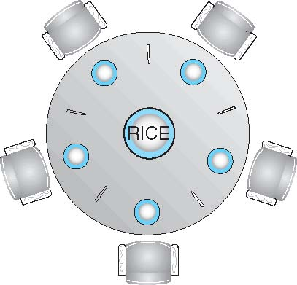

Dining-Philosophers Problem
Philosophers spend their lives alternating thinking and eating
When thinking
Don’t interact with their neighbors
When hungry-
A philosopher needs both their right and left chopstick to eat.
A hungry philosopher may only eat if there are both chopsticks available

Slide 80
Dining-Philosophers Problem
Occasionally try to pick up 2 chopsticks that are closest to her to eat from bowl
Chopsticks that are between her and her left and right neighbor
Pick up only one at a time
Need both to eat, then release both when done

Slide 81
Dining-Philosophers Problem
Classic Synchronization problem
Example of large class of concurrency control problems
Represents the need to allocate several resources among several processes
in a deadlock free and starvation free manner

Slide 82
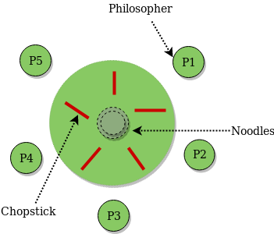
Dining-Philosophers Problem
5 Philosophers share a common circular table
Surrounded by 5 chairs=each belonging to one philosopher
Center of table ->Bowl of rice
Five single chopsticks
Shared data
Bowl of rice (data set)
Semaphore chopstick [5] initialized to 1

Slide 83
Semaphore Solution for Dining-Philosophers Problem
Grab the chopstick –By Executing wait operation on the semaphore
Release the chopstick-By executing the signal operation on the appropriate semaphore
Semaphore chopstick [5] initialized to 1

Slide 84
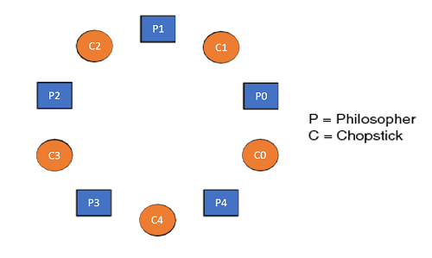
Semaphore Solution for Dining-Philosophers Problem Algorithm
The structure of Philosopher i:
do {
wait (chopstick[i] );
wait (chopStick[ (i + 1) % 5] );
// eat
signal (chopstick[i] );
signal (chopstick[ (i + 1) % 5] );
// think
} while (TRUE);

Slide 85
Semaphore Solution for Dining-Philosophers Problem Algorithm
What is the problem with this algorithm?

Slide 86
Semaphore Solution for Dining-Philosophers Problem Algorithm
What is the problem with this algorithm?
Algorithm Guarantees that No two neighbors are eating simultaneously
Still Must be rejected
Why?

Slide 87
Semaphore Solution for Dining-Philosophers Problem Algorithm
Why?
Possibility of deadlock
If all 5 philosophers are hungry simultaneously and each grabs left chopstick
All elements of chopsticks will be =0
When each philosopher tries to grab her right chopstick, delayed forever

Slide 88
Dining Philosopher’s problem
Assumptions:
There are 5 philosophers (can be generalized to any number).
Philosophers alternate between thinking and eating.
Philosophers must pick up two chopsticks (left and right) to eat.
A semaphore controls access to chopsticks.

Slide 89
#define N 5 // Number of philosophers
semaphore chopstick[N]; // Semaphores representing chopsticks (binary semaphores)
// Philosopher function representing actions of each philosopher
void philosopher(int i) {
while (true) {
think(); // Think , non-CS activity
// Pick up left chopstick (chopstick[i])
wait(chopstick[i]);
// Pick up right chopstick (chopstick[(i+1)%N])
wait(chopstick[(i + 1) % N]);
eat(); // Eat – CS activity
// Put down right chopstick
signal(chopstick[(i + 1) % N]);
// Put down left chopstick
signal(chopstick[i]);
}
}
int main() {
// Initialize all semaphores to 1 (available chopsticks)
for (int i = 0; i < N; i++) {
init_semaphore(chopstick[i], 1);
}
// Create threads/processes for each philosopher
for (int i = 0; i < N; i++) {
create_thread(philosopher, i);
}
// Join threads if needed (depends on implementation)
join_threads();
return 0;
}
Solution I

Slide 90
Analysis
Semaphores (chopstick[i]): Each chopstick is represented by a semaphore initialized to 1, indicating that it is available.
wait(): A philosopher waits for the chopstick (decrements the semaphore).
signal(): After eating, a philosopher releases the chopstick (increments the semaphore).
Thinking: Simulated by think().
Eating: Simulated by eat().

Slide 91
Analysis
Mutual Exclusion?
Livelock / progress?
Deadlock?
Possible if all philosophers pick up left chopstick and wait for right chopstick, creating circular wait and hold and wait.
Starvation?
a philosopher might wait indefinitely if others repeatedly eat before it.

Slide 92
Semaphore Solution for Dining-Philosophers Problem Algorithm
Deadlock handling
Allow at most 4 philosophers to be sitting simultaneously at the table.
Allow a philosopher to pick up the forks only if both are available (picking must be done in a critical section)
Use an asymmetric solution --
Odd-numbered philosopher picks up first the left chopstick and then the right chopstick.
Even-numbered philosopher picks up first the right chopstick and then the left chopstick

Slide 93
// Number of philosophers
#define N 5
semaphore chopstick[N]; // Semaphores representing chopsticks (binary semaphores)
// counting semaphore ‘limit’ to ensure only N-1 philosophers can access chopsticks at a time
semaphore limit;
void philosopher(int i) {
while (true) {
think(); // Think : non-CS activity
// Wait for permission to access chopsticks (only N-1 philosophers can proceed)
wait(limit);
wait(chopstick[i]); // Pick up left chopstick (chopstick[i])
wait(chopstick[(i + 1) % N]); // Pick up right chopstick (chopstick[(i+1)%N])
eat(); //process
signal(chopstick[(i + 1) % N]); // Put down right chopstick
signal(chopstick[i]); // Put down left chopstick
// Signal that philosopher is done eating, allowing another philosopher to proceed
signal(limit);
}
}
int main() {
// Initialize all chopsticks to 1 (available)
for (int i = 0; i < N; i++) {
init_semaphore(chopstick[i], 1);
}
// Initialize mutex to N-1 to allow only N-1 philosophers to pick up chopsticks at a time
init_semaphore(limit, N-1);
// Create threads/processes for each philosopher
for (int i = 0; i < N; i++) {
create_thread(philosopher, i);
}
// Join threads if needed (depends on implementation)
join_threads();
return 0;
}
Solution II - deadlock-free, starvation-free, and livelock-free

Slide 94
Analysis
Preventing Deadlock:
central semaphore mutex (or binary semaphore) ensures that philosophers can only pick up chopsticks if both are available.
Preventing Starvation:
central semaphore (mutex) allows only N-1 philosophers to pick up chopsticks at a time.
Ensures philosophers take turns eating, and no philosopher can indefinitely hold chopsticks if others are waiting.
This ensures that there will always be at least one philosopher who can eat.
Achieving Mutual Exclusion:
Each chopstick is still protected by a semaphore, ensuring mutual exclusion. Only one philosopher can hold a chopstick at a time.
Preventing Livelock:
Philosophers will only proceed when they have both chopsticks, and the introduction of mutex ensures that the system does not get stuck in an endless cycle of picking up and putting down chopsticks.

Slide 95
Readers-Writers Problem

Slide 96
Readers-Writers Problem
Process Synchronization Problem
A Database/Data set/Object/File/Record is shared among a number of concurrent processes
Readers – only read the data set; they do not perform any updates
Writers – can both read and write i.e. update

Slide 97
Readers-Writers Problem
Problem –
Allow multiple readers to read at the same time, no adverse effects
If a writer and some other process(reader/writer) access shared object simultaneously chaos may ensue
Requirements
Writers must have exclusive access to the shared object
R-W : not permitted
W-R : not permitted
W-W : not permitted
R-R : permitted

Slide 98
Concurrency and Synchronization Issues
1. Race Condition:
- If a reader or writer does not acquire locks correctly before accessing the shared resource, a race condition can occur, leading to inconsistent or corrupted data.
- For example, if a reader is reading data while a writer is modifying it, the reader may get inconsistent data.
2. Mutual Exclusion:
- Writers need mutual exclusion to prevent simultaneous write operations, which could lead to data corruption.
- Readers don’t need mutual exclusion from each other, but they need to ensure that no writer is modifying the resource when they are reading.
3. Deadlock:
- Deadlock can occur if readers and writers are blocked waiting for each other in a circular dependency.
- For example, a writer is waiting for readers to finish, while readers are waiting for the writer to release the resource.

Slide 99
Concurrency and Synchronization Issues
4. Starvation:
- Starvation occurs when one group (readers or writers) is continually given priority, preventing the other group from accessing the resource.
- Writer Starvation: If the system gives continuous priority to readers, writers may starve (never get a chance to write). This is known as Reader Priority.
- Reader Starvation: If writers are given priority over readers, readers may starve if new writers keep coming. This is called Writer Priority.
5. Fairness:
- A fair solution must ensure that both readers and writers get a reasonable opportunity to access the resource.
- Fairness is about avoiding starvation and ensuring that neither readers nor writers are indefinitely delayed.

Slide 100
Example- a library catalog
Ordinary users of the library read the catalog to locate a book.
One or more librarians are able to update the catalog.
In the general solution-
every access to the catalog would be treated as a critical section, and
users would be forced to read the catalog one at a time.
would clearly impose intolerable delays.
At the same time, it is important to prevent writers from interfering with each other
it is also required to prevent reading while writing is in progress to prevent the access of inconsistent information.

Slide 101
Producer/Consumer vs Readers/Writers
Can we take a single writer (the producer) and a single reader (the consumer)?
The answer is no.
The producer is not just a writer.
It must read queue pointers to determine where to write the next item,
it must determine if the buffer is full.
Similarly, the consumer is not just a reader,
it must adjust the queue pointers to show that it has removed a unit from the buffer.
Reader must maintain queue pointers to determine where to read the next item

Slide 102
Readers-Writers Problem
Several variations– all involving priorities
Reader priority Problem-
No reader will be kept waiting unless a writer has already obtained permission to use the shared object.
No reader should wait for other readers to finish simply because a writer is waiting
Writer priority Problem-
Once a writer is ready , that writer performs its write as soon as possible
If a writer is waiting to access the object, no new readers may start reading
Fair policy reader-writer problem

Slide 103
R-W Problem
The structure of a reader process
do { wait(mutex); read_count++; if (read_count == 1)
wait(rw_mutex);
signal(mutex);
... /* reading is performed */
...
wait(mutex); read count--; if (read_count == 0)
signal(rw_mutex);
signal(mutex);
} while (true);
Reader
Initially readcount=0
First Reader R1 tries to enter
wait mutex so mutex=0
readcount=1
if readcount is one i.e. First reader
wait rw_mutex so rw_mutex=0
readcount updation finished so signal mutex, mutex=1
Reader enters CS
“Reader R1 is reading”
Writer
Now Writer tries to enter
It executes his code
wait(rw_mutex)
gets trapped in infinite loop as rw_mutexwas already 0 (reader priority)
Writer cannot enter CS
do{ wait(rw_mutex);
... /* writing is performed */
...
signal(rw_mutex);
} while (true);

Slide 104
W-R Problem
The structure of a reader process
do { wait(mutex); read_count++; if (read_count == 1)
wait(rw_mutex);
signal(mutex);
... /* reading is performed */
...
wait(mutex); read count--; if (read_count == 0)
signal(rw_mutex);
signal(mutex);
} while (true);
Writer1
Initally rw_mutesx=1
First Writer W1 tries to enter CS
wait operation
rw_mutex becomes 0
Writer W1 enters CS
Reader1
Initially mutex=1,readcount=0
Now reader R1 tries to enter CS
wait mutex
mutex=0
readcount=1
In if section,
wait(rw_mutex)
gets trapped in infinite loop (Writer priority)
Reader Cannot enter CS
do{ wait(rw_mutex);
... /* writing is performed */
...
signal(rw_mutex);
} while (true);

Slide 105
W-W Problem
The structure of a reader process
do { wait(mutex); read_count++; if (read_count == 1)
wait(rw_mutex);
signal(mutex);
... /* reading is performed */
...
wait(mutex); read count--; if (read_count == 0)
signal(rw_mutex);
signal(mutex);
} while (true);
Writer1
Initally rw_mutes=1
First Writer W1 tries to enter CS
wait operation
rw_mutex becomes 0
Writer W1 enters CS
Writer2
Another Writer W2 tries to enter CS
wait operation
rw_mutex is 0
Thus trapped in Infinite loop
Writer Cannot enter CS
do{ wait(rw_mutex);
... /* writing is performed */
...
signal(rw_mutex);
} while (true);

Slide 106
R-R Problem
Reader1
Initially readcount=0
First Reader R1 tries to enter
wait mutex so mutex=0
readcount=1
if readcount is one i.e. First reader
wait rw_mutex so rw_mutex=0
readcount updation finished so signal mutex,
mutex=1
Reader enters CS
“Reader R1 is reading”
The structure of a reader process
do { wait(mutex); read_count++; if (read_count == 1)
wait(rw_mutex);
signal(mutex);
... /* reading is performed */
...
wait(mutex); read count--; if (read_count == 0)
signal(rw_mutex);
signal(mutex);
} while (true);
Reader2
Reader R2 tries to enter CS
wait mutes so mutex=0
readcount=2
Does not enter If section
signal mutex
mutex=1
Reader R2 Enters CS
do{ wait(rw_mutex);
... /* writing is performed */
...
signal(rw_mutex);
} while (true);

Slide 107
Mutex solution for fair readers-writers problem
//Reader
function Reader(){
while true:
Lock(mutex) // Lock to update read_count
read_count = read_count + 1 // Increment the number of readers
if read_count == 1: // If this is the first reader
Wait(wrt) // Wait for writer access (lock for writing)
Unlock(mutex) // Unlock after updating read_count
// Critical Section (Reading)
Read from shared resource // Perform read operation
Lock(mutex) // Lock to update read_count
read_count = read_count - 1 // Decrement the number of readers
if read_count == 0: // If this is the last reader
Signal(wrt) // Signal that writers can access
Unlock(mutex) // Unlock after updating read_count
}//reader
//Initialize:
mutex = CreateMutex() // Mutex for synchronizing read_count
wrt = CreateSemaphore(1) // Semaphore for writer access
read_count = 0 // Number of active readers
//Writer
function Writer(){
while true:
Wait(wrt) // Wait for exclusive access to write
// Critical Section (Writing)
Write to shared resource // Perform write operation
Signal(wrt) // Release exclusive access
}//writer

Slide 108
Analysis of Fairness
No starvation: The solution avoids both reader and writer starvation. Writers wait for ongoing readers to finish but will not be indefinitely delayed because once the last reader finishes, the writer gets exclusive access.
Mutual Exclusion: Writers always get exclusive access to the critical section.
Reader Priority: Readers are given priority in the sense that multiple readers can access the resource simultaneously, while writers have to wait if there are any active readers. However, once a writer starts, no new readers can access the resource until the writer finishes.
Possible Edge Cases:
Writer starvation in case of frequent readers: While writers aren't starved in this implementation, there is a slight delay for writers if readers continuously arrive. However, this delay is minimal due to the condition that only when read_count == 0 can a writer access the resource.

Slide 109
Solution for Fair Readers-Writers Problem Using Semaphores
//Reader
function Reader(){
while true:
Wait(read_lock) // Wait to enter reader section
Wait(mutex) // Lock to update read_count
read_count = read_count + 1 // Increment reader count
if read_count == 1: // If this is the first reader
Wait(wrt) // Wait for writer access
Signal(mutex) // Unlock after updating read_count
Signal(read_lock) // Allow other readers to enter
// Critical Section (Reading)
Read from shared resource // Perform read operation
Wait(mutex) // Lock to update read_count
read_count = read_count - 1 // Decrement reader count
if read_count == 0: // If this is the last reader
Signal(wrt) // Signal that writers can access
Signal(mutex) // Unlock after updating read_count
}//reader
Initialize:
mutex = CreateSemaphore(1) // Mutex to protect read_count
wrt = CreateSemaphore(1) // Semaphore for writer access
read_count = 0 // Number of active readers
read_lock = CreateSemaphore(1) // Semaphore for reader access
//Writer
function Writer(){
while true:
Wait(wrt) // Wait for exclusive access to write
// Critical Section (Writing)
Write to shared resource // Perform write operation
Signal(wrt) // Release exclusive access
}//writer

Slide 110
Fairness & Performance Summary
Reader-Reader Fairness: Multiple readers can read the shared resource concurrently. The use of read_lock prevents contention among readers when they try to increment or decrement read_count. The design ensures fair access for all readers without starving any particular reader.
Reader-Writer Fairness: Writers are not starved, as they will eventually access the shared resource once all current readers finish. The use of wrt ensures that new readers cannot start reading while a writer is waiting, which promotes fairness between readers and writers.
Writer-Writer Fairness: Writers access the shared resource one at a time in a fair manner due to the wrt semaphore. No writer is starved, and they get serialized access.
Writer-Reader Fairness: Writers have to wait for readers to finish, and once they begin writing, no readers can enter until the writer finishes. This promotes a fair balance between readers and writers.

Slide 111
Fair share with semaphores- Starvation and Livelock Considerations
No Starvation: Both readers and writers get a fair share of access to the shared resource. Readers can access concurrently, and writers get their exclusive access once readers are done. The use of semaphores ensures that no group (readers or writers) will be indefinitely delayed.
No Livelock: The solution prevents livelock since the read_lock semaphore ensures that readers can't endlessly preempt writers. Writers are guaranteed eventual access after all readers finish.

Slide 112
Solution to readers-writers : comparison
Fairness for Writers | Writers may starve in a read-heavy environment. | Fair, as read_lock prevents new readers when a writer is waiting. | Writers get exclusive access but may wait behind readers.
Mutual Exclusion | Handled using mutex for writers, but readers share access. | Handled with wrt for writers, fine-tuned with semaphores. | Managed automatically via monitor’s internal locks.
Complexity | Simple to implement, especially for readers. | More complex due to multiple semaphores for fairness. | Simplified due to high-level abstraction, fewer details.
Performance | Efficient for concurrent readers, but may starve writers. | Good performance but with extra overhead for managing semaphores. | Performance may vary depending on monitor implementation.
Starvation/ Livelock | Writer starvation possible. | No starvation for either group if semaphores are properly managed. | Can be designed to avoid starvation using condition variables.

Slide 113
Monitors

Slide 114
Monitors
A high-level synchronization construct
Set of programmer defined operators
Declaration of variables
whose value define the state of an instance of the type
Bodies of procedures
that implement operations on the type

Slide 115
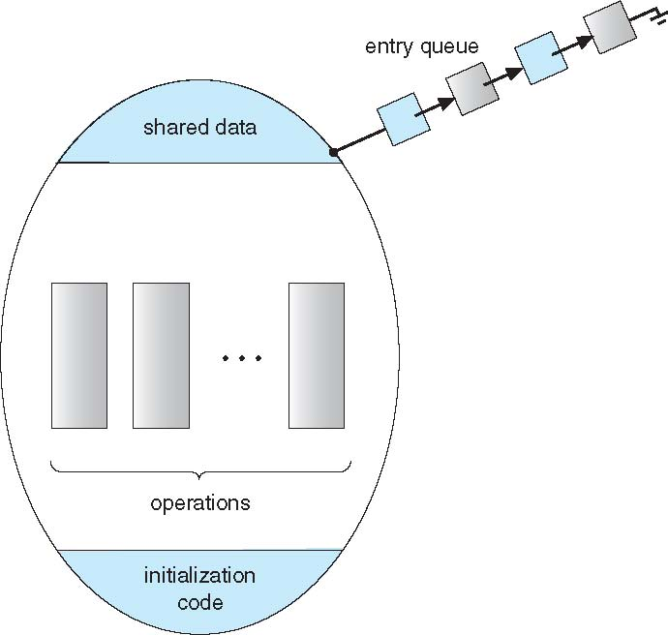
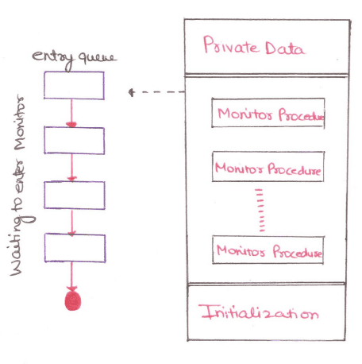
Schematic view of a Monitor

Slide 116
Syntax of Monitors
monitor monitor-name
{
// shared variable declarations
procedure P1 (…) { …. }
procedure Pn (…) {……}
Initialization code (…) { … }
}
}

Slide 117
Monitors
Abstract data type, internal variables only accessible by code within the procedure
Procedure defined within the monitor can access only those variables
declared locally within the monitor and
its formal parameters.
monitor monitor-name
{
// shared variable declarations
procedure P1 (…) { …. }
procedure Pn (…) {……}
Initialization code (…) { … }
}
}

Slide 118
Monitors
It is the collection of condition variables and procedures combined together in a special kind of module or a package.
The processes running outside the monitor can’t access the internal variable of the monitor but can call procedures of the monitor.
Only one process at a time can execute code inside monitors.

Slide 119
Monitors
Monitor ensures that
Only one process may be active within the monitor at a time
Programmer does not need to
code the synchronization constraint explicitly
But not powerful enough to model some synchronization schemes
Need to define additional condition construct

Slide 120
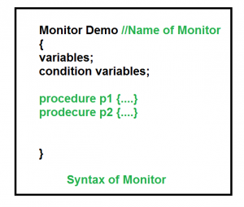
Condition Variables
Programmer can define one or more condition variables
condition x, y;
Only Two operations are allowed on a condition variable:
x.wait()
x.signal()

Slide 121
Condition Variables
x.wait() –
Process performing wait operation on any condition variable are suspended.
suspended until x.signal()
The suspended processes are placed in block queue of that condition variable.
x.signal() –
When a process performs signal operation on condition variable, one of the blocked processes is given chance.
resumes one of processes (if any) that invoked x.wait()
If no process is suspended, then it has no effect on the variable
State of x, As if the operation was never executed
In contrast to semaphore, state of semaphore always gets affected

Slide 122
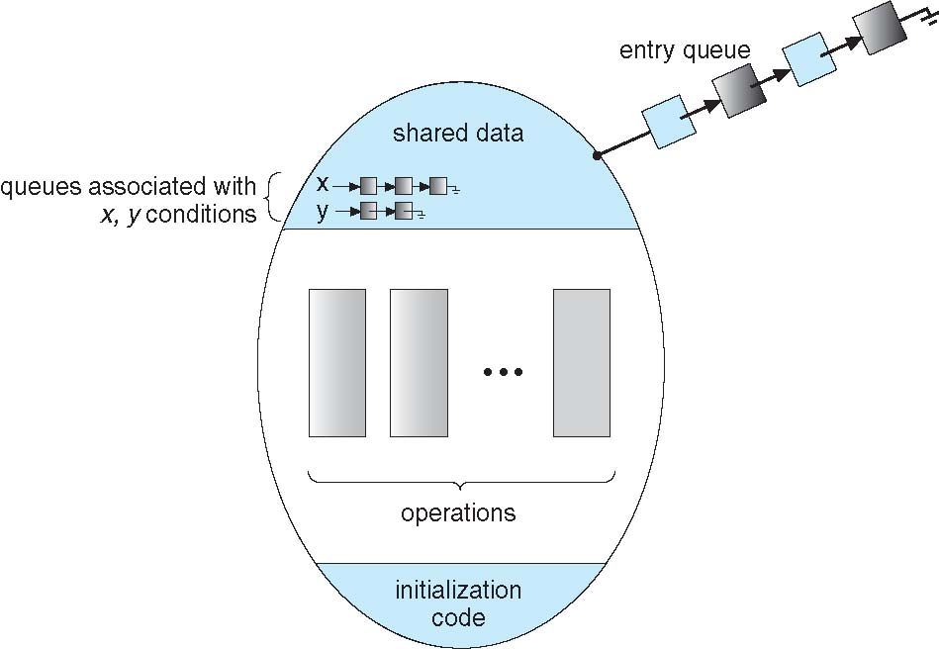
Monitor with Condition Variables

Slide 123
Condition Variables Choices
If process P invokes x.signal(), and process Q is suspended in x.wait(),
Suspended process Q associated with condition x is invoked
what should happen next?
Both Q and P cannot execute in parallel.
If Q is resumed, then P must wait
Otherwise both P and Q will be active simultaneously within the monitor

Slide 124
Condition Variables Choices
Options include
Signal and wait – P waits until Q either leaves the monitor or it waits for another condition
Signal and continue – Q waits until P either leaves the monitor or it waits for another condition

Slide 125
Condition Variables Choices
Since P was already executing in the monitor,
Option 2 seems more reasonable
However, If P continues, the logical condition for which Q was waiting may no longer hold by the time Q is resumed
Both have pros and cons – language implementer can decide
Monitors implemented in Concurrent Pascal compromise
P executing signal immediately leaves the monitor, Q is resumed
Implemented in other languages including Mesa, C#, Java

Slide 126
Monitor control structure
monitor <MonitorName> {
// Shared resources (variables, data structures) are declared as private
private:
<shared variables>;
// Condition variables to manage synchronization
condition <ConditionVariable1>;
condition <ConditionVariable2>;
// More condition variables as needed
// Entry procedures (only one thread is allowed to execute one of these at a time)
public:
procedure <Operation1>(parameters) {
// Synchronization logic
// Access shared resources
// Possibly wait or signal condition variables
}
procedure <Operation2>(parameters) {
// Synchronization logic
// Access shared resources
// Possibly wait or signal condition variables
}
// Initialization procedure to initialize shared resources
procedure Init() {
// Initialize shared resources
}
}

Slide 127
Bounded buffer PC using Monitors
// Monitor Structure
monitor BoundedBuffer {
condition not_full; // Condition variable for buffer not being full
condition not_empty; // Condition variable for buffer not being empty
item buffer[MAX_SIZE]; // The shared buffer
int in = 0, out = 0, count = 0; // Pointers and count for the circular buffer
// Add an item to the buffer (Producer)
procedure add_item(item x) {
if (count == MAX_SIZE) {
wait(not_full); // Wait until there is space in the buffer
}
buffer[in] = x; // Add the item to the buffer
in = (in + 1) % MAX_SIZE; // Circular buffer
count++; // Update the count
signal(not_empty); // Signal that buffer is no longer empty
} // procedure add_item
// Remove an item from the buffer (Consumer)
procedure remove_item() -> item {
if (count == 0) {
wait(not_empty); // Wait until there is an item in the buffer
}
item x = buffer[out]; // Remove the item from the buffer
out = (out + 1) % MAX_SIZE; // Circular buffer
count--; // Update the count
signal(not_full); // Signal that buffer is no longer full
return x;
} // procedure remove_item
} // monitor
// Producer
function producer() {
while (true) {
item = produce_item(); // Produce an item
// Add the item to the shared buffer
BoundedBuffer.add_item(item);
}
}// producer
// Consumer \
function consumer() {
while (true) {
// Remove the item from the shared buffer
item = BoundedBuffer.remove_item();
consume_item(item); // Consume the item
}
}// consumer

Slide 128
Explanation of Solution
Monitor:
- The monitor encapsulates the shared buffer (`buffer[]`), the `in` and `out` pointers for the circular buffer, and the `count` variable to track the number of items.
- Mutual exclusion is inherently managed by the monitor.
- Only one thread (either a producer or a consumer) can execute a monitor procedure at a time, ensuring safe concurrent access.
2. Condition Variables:
- not_full: The producer will wait on this condition if the buffer is full. When the consumer removes an item and signals the producer, the producer can add a new item to the buffer.
- not_empty: The consumer will wait on this condition if the buffer is empty. When the producer adds an item and signals the consumer, the consumer can remove the item from the buffer.
3. Producer:
- When the producer wants to add an item, it first checks if the buffer is full (i.e., `count == MAX_SIZE`). If the buffer is full, the producer waits on the `not_full` condition.
- After the consumer consumes an item and signals the producer (via `signal(not_full)`), the producer resumes, adds the item to the buffer, and then signals the consumer (via `signal(not_empty)`) that the buffer is no longer empty.
4. Consumer:
- When the consumer wants to remove an item, it first checks if the buffer is empty (i.e., `count == 0`). If the buffer is empty, the consumer waits on the `not_empty` condition.
- After the producer produces an item and signals the consumer (via `signal(not_empty)`), the consumer resumes, removes the item from the buffer, and then signals the producer (via `signal(not_full)`) that the buffer is no longer full.

Slide 129
Analysis of Solution
1. Mutual Exclusion:
- The monitor guarantees that only one thread can be inside the `add_item` or `remove_item` procedures at a time.
- This ensures mutual exclusion, as it prevents race conditions when accessing the shared buffer. The `mutex` is implicitly managed by the monitor, so no additional locking mechanism is required.
2. Condition Synchronization:
- Blocking: The producer is blocked if the buffer is full, and the consumer is blocked if the buffer is empty. Condition variables (`not_full` and `not_empty`) ensure that producers and consumers only proceed when it is safe to do so.
- Signaling: Producers signal consumers when an item is added (buffer not empty), and consumers signal producers when an item is consumed (buffer not full). This ensures that producers and consumers are awakened when their conditions change.
3. Deadlock-Free:
- The solution is deadlock-free because producers and consumers only wait when necessary (on full or empty conditions). Once the buffer state changes (due to item addition or removal), the corresponding waiting process is signaled to continue.
4. Fairness and Starvation:
- Fairness: No producer or consumer will starve, as each process waiting on the condition variable (`not_full` or `not_empty`) will be signaled as soon as the required condition is satisfied.
- No Starvation: Every producer will eventually add its item to the buffer when space is available, and every consumer will eventually consume an item when one is available

Slide 130
Monitors
Advantages of Monitor:
Make parallel programming easier and
less error prone than using techniques such as semaphore.
Disadvantages of Monitor:
Monitors have to be implemented as part of the programming language .
The compiler must generate code for them.
This gives the compiler the additional burden of having to know what operating system facilities are available to control access to critical sections in concurrent processes.
Some languages that do support monitors are Java,C#,Visual Basic,Ada and concurrent Euclid.

Slide 131
Monitor Solution to Dining Philosophers
Deadlock free solution to Dining Philosophers Problem
To distinguish amongst the 3 states in which the philosopher may be-
enum { THINKING; HUNGRY, EATING) state [5] ;
Philosopher i can set the variable state [i] = EATING only
if her two neighbors are not eating
(state [ (i +4) % 5] ! = EATING) and (state [ (i +1) % 5] != EATING)

Slide 132
Monitor Solution to Dining Philosophers
Also need to declare
condition self[5];
in which i^{th} philosopher can delay herself when she is hungry but is unable to obtain the chopsticks she needs.
Distribution of chopsticks is controlled by the monitor DiningPhilosophers

Slide 133
Monitor Solution to Dining Philosophers
monitor DiningPhilosophers
{
enum { THINKING; HUNGRY, EATING) state [5] ;
condition self [5];
void pickup (int i) {
state[i] = HUNGRY;
test(i);
if (state[i] != EATING)
self[i].wait;
}
Pickup chopsticks
If unable to eat, wait to be signaled
Philosopher can delay herself when she is hungry but is unable to obtain the chopsticks she needs.

Slide 134
Monitor Solution to Dining Philosophers
monitor DiningPhilosophers
{
void putdown (int i) {
state[i] = THINKING;
// test left and right neighbors
test((i + 4) % 5);
test((i + 1) % 5);
}
Put down chopsticks
if right neighbor R=(i+1)%5 is hungry and
both of R’s neighbors are not eating,
set R’s state to eating and wake up neighbour R by signaling

Slide 135
Monitor Solution to Dining Philosophers
void test (int i) {
if ((state[(i + 4) % 5] != EATING) &&
(state[i] == HUNGRY) &&
(state[(i + 1) % 5] != EATING) ) {
state[i] = EATING ;
self[i].signal () ;
}
}
initialization_code() {
for (int i = 0; i < 5; i++)
state[i] = THINKING;
}
}
If her two neighbors are not eating and she is hungry
I.E. if my left and right neighbors are not eating
Set her state as eating
signal() has no effect during Pickup(),
but is important to wake up waiting hungry philosophers during Putdown()

Slide 136
Solution to Dining Philosophers
Each philosopher i invokes the operations pickup() and putdown() in the following sequence:
DiningPhilosophers.pickup(i);
EAT
DiningPhilosophers.putdown(i);
No deadlock, but starvation is possible

Slide 137
Solution to Dining Philosophers
Each philosopher, before starting to eat, must invoke the operation pickup().
This act may result in the suspension of the philosopher process.
After the successful completion of the operation, the philosopher may eat.
After eating, philosopher invokes putdown() and start to think

Slide 138
Solution to Dining Philosophers
Execution of Pickup(), Putdown() and test() are all mutually exclusive, i.e. only one at a time can be executing
No 2 neighbors are eating simultaneously
So No deadlock, but starvation is possible

